Slide 1



Submitted by: Code Riders
Submission type : Group
Name: Niket Suresh Padole, Ajinkya Murlidhar Ingle, Ayush Priyadarshi Subhrajit Dash, Chamarthi Rohith Kumar Raju
Batch : AXIS SJA BATCH 5
Program : Axis Java-School of Advanced Computing
Date: 27/06/2024

Slide 2


Table of contents
Introduction
Project Overview
GitHub
Agile Methodology
Application Flow Design
Architecture Design
Front-end Development
Back-end Development
Database
Testing
Deployment
CI/CD
Conclusion
Challenges
Future Work
References

Slide 3

Introduction
ShareMyTrip is an innovative ride-sharing application designed to connect drivers with passengers looking for a convenient and cost-effective means of transportation.
By facilitating carpooling arrangements, ShareMyTrip aims to reduce travel costs, alleviate traffic congestion, and promote environmental sustainability.
The application leverages a microservices architecture to ensure scalability, reliability, and ease of maintenance.

Slide 4
Project Overview
Features and Functionality
Registration and Authentication :
Secure user registration process
Ride Booking :
Easily book rides with intuitive scheduling and route options.
Driver Matching :
Efficiently match drivers and passengers based on preferences and location.
Trip Management :
View detailed ride history.
Payment Processing :
Secure payment process.
Multi Payment option.

Slide 5
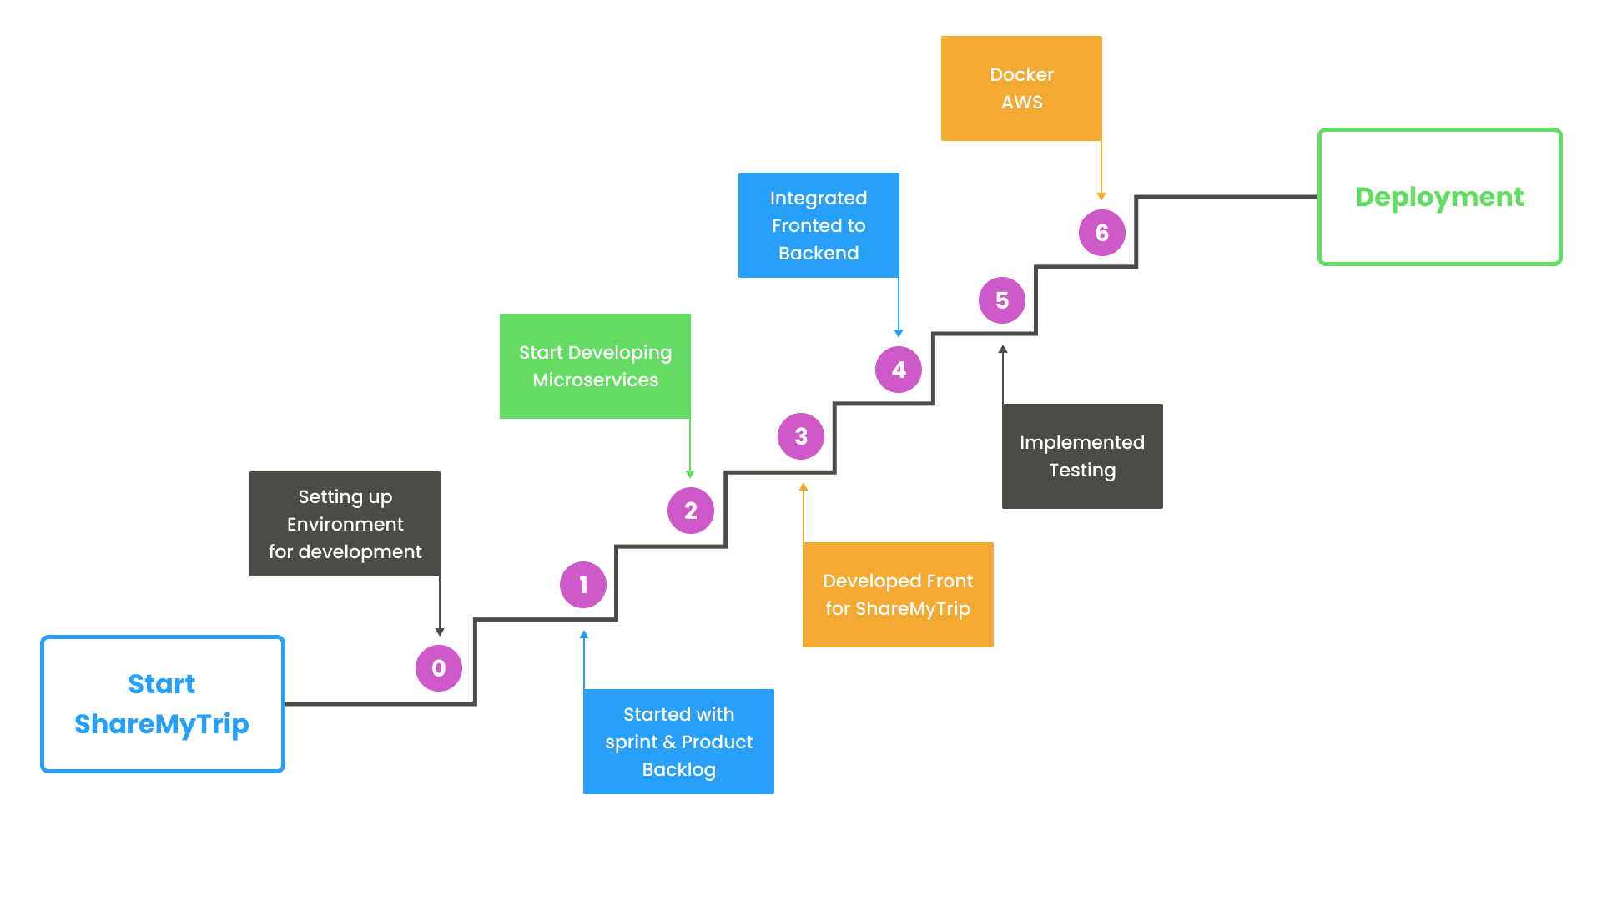
Project Overview

Slide 6
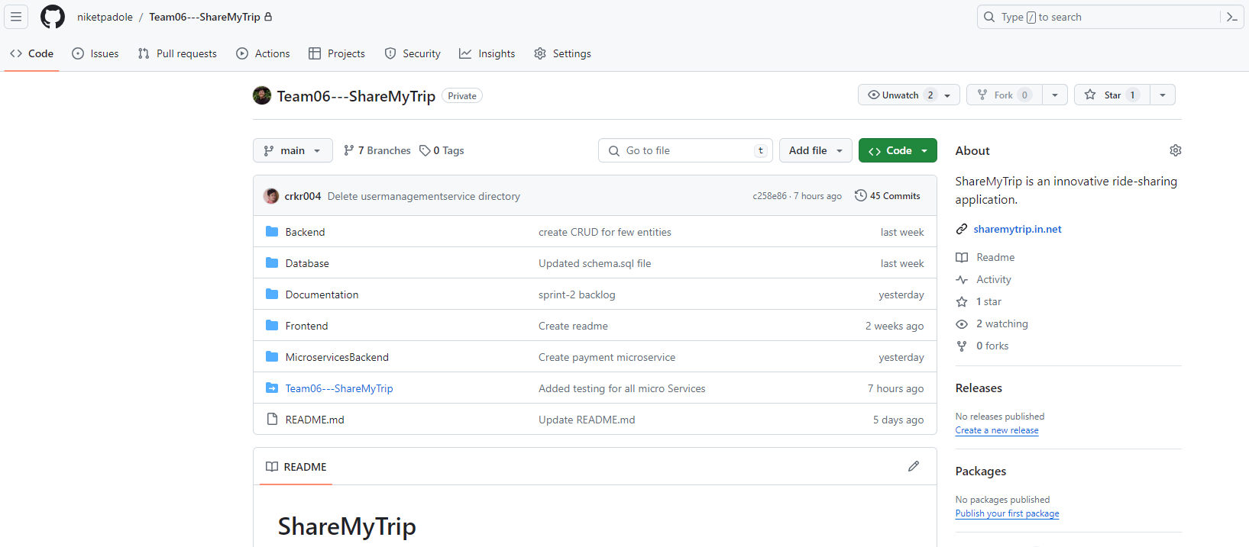
GitHub
URL: https://github.com/niketpadole/Team06---ShareMyTrip.git

Slide 7
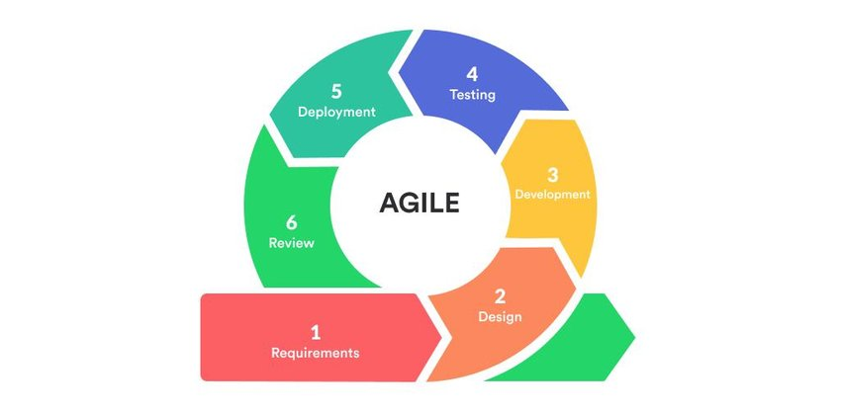
Agile Methodology
Agile methodology drives our development process in the ShareMyTrip project, promoting collaboration, flexibility, and continuous improvement.
We adhere to the Scrum framework, with regular sprint cycles consisting of planning, execution, review, and reflection.

Slide 8

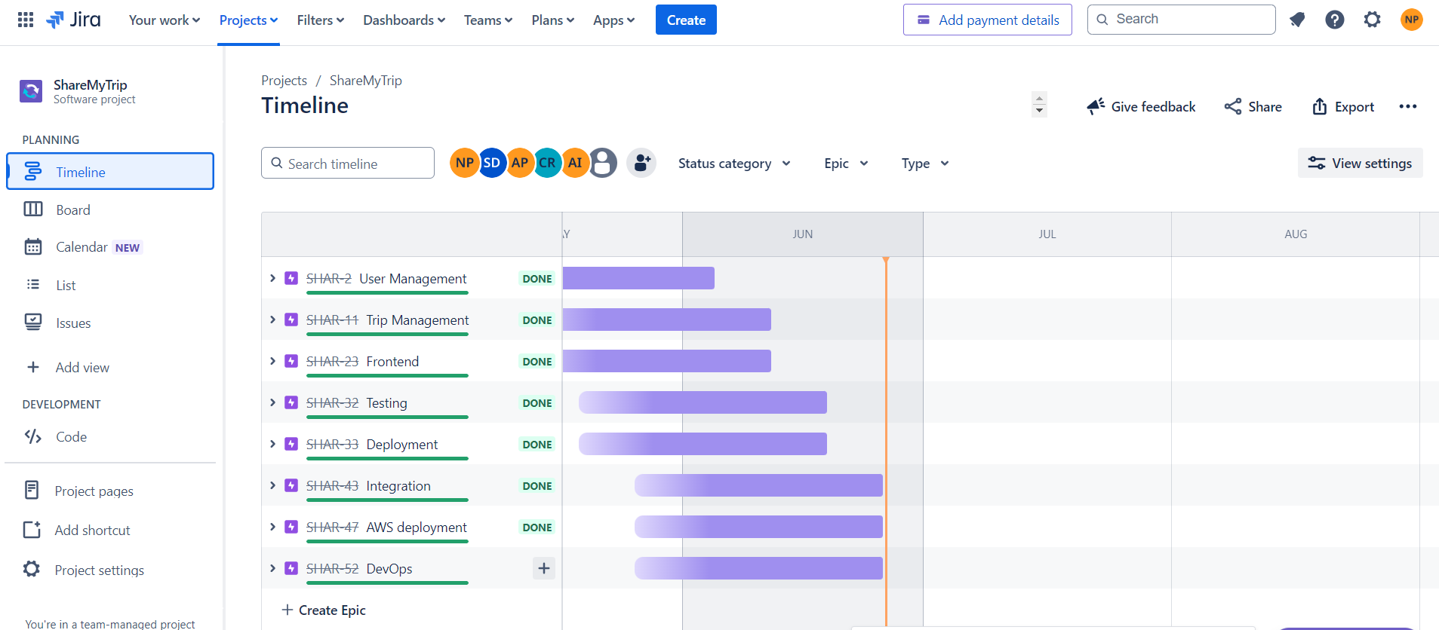
Project Management
Jira Integration:
Jira serves as our primary project management tool, allowing us to create, track, and prioritize tasks.
URL: https://niketpadole.atlassian.net/jira/software/projects/SHAR/boards/2

Slide 9
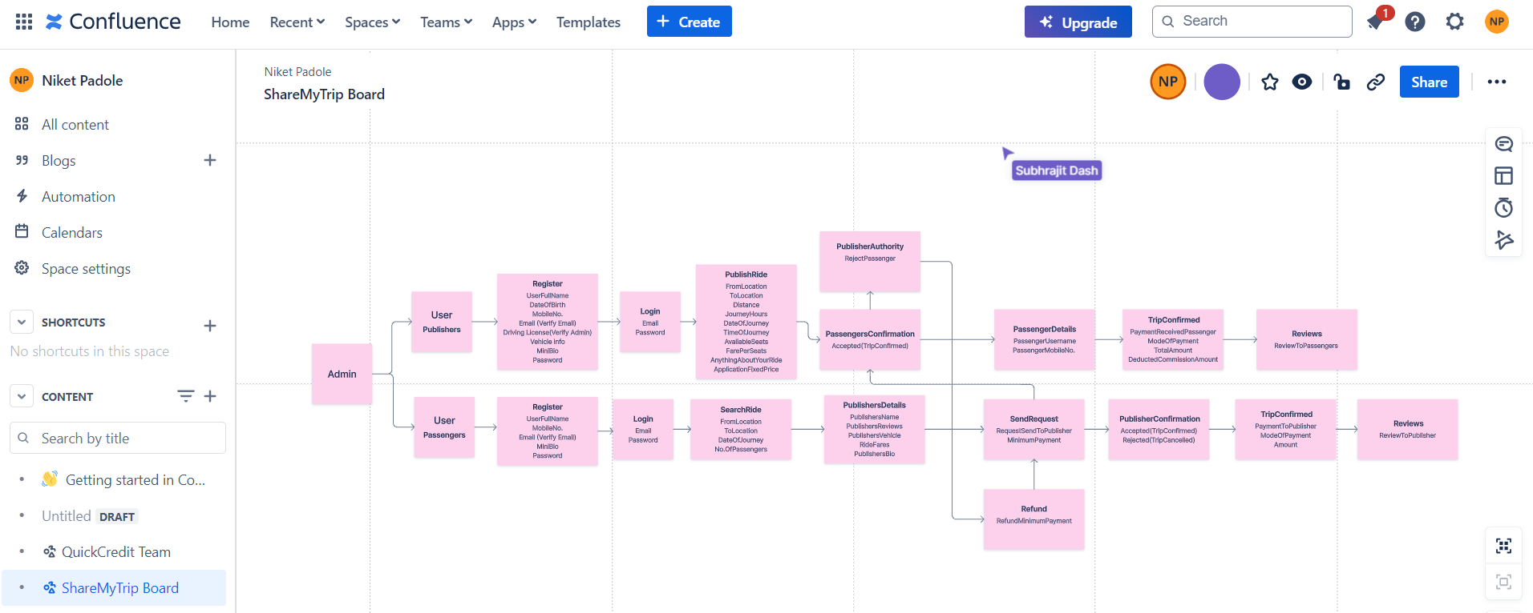
Project Tracking Tool (Confluence)
URL: https://niketpadole.atlassian.net/l/cw/Nnfqib6k

Slide 10
Product Backlog Report
The product backlog serves as the backbone of our project, guiding prioritization, planning, and execution.
It encompasses user stories, epics, tasks, bugs, and technical debt, providing a comprehensive view of project requirements.
URL: https://share-my-trip.s3.ap-south-1.amazonaws.com/agile/Product_Backlog_final.pdf

Slide 11
Sprint Backlog Report
It comprises selected user stories from the product backlog, broken down into manageable tasks with clear acceptance criteria.
Provides focus and clarity for the team, ensuring efficient workflow and progress tracking.
URL: https://share-my-trip.s3.ap-south-1.amazonaws.com/agile/sprint-backlog_final.pdf

Slide 12
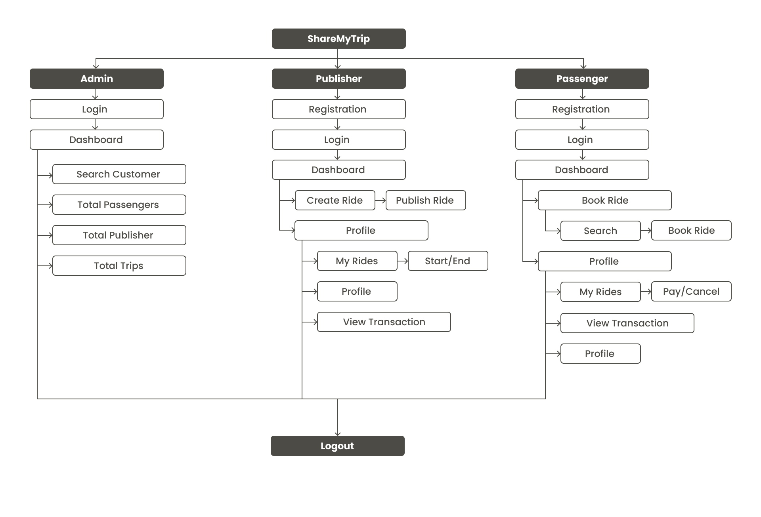
Flowchart

Slide 13
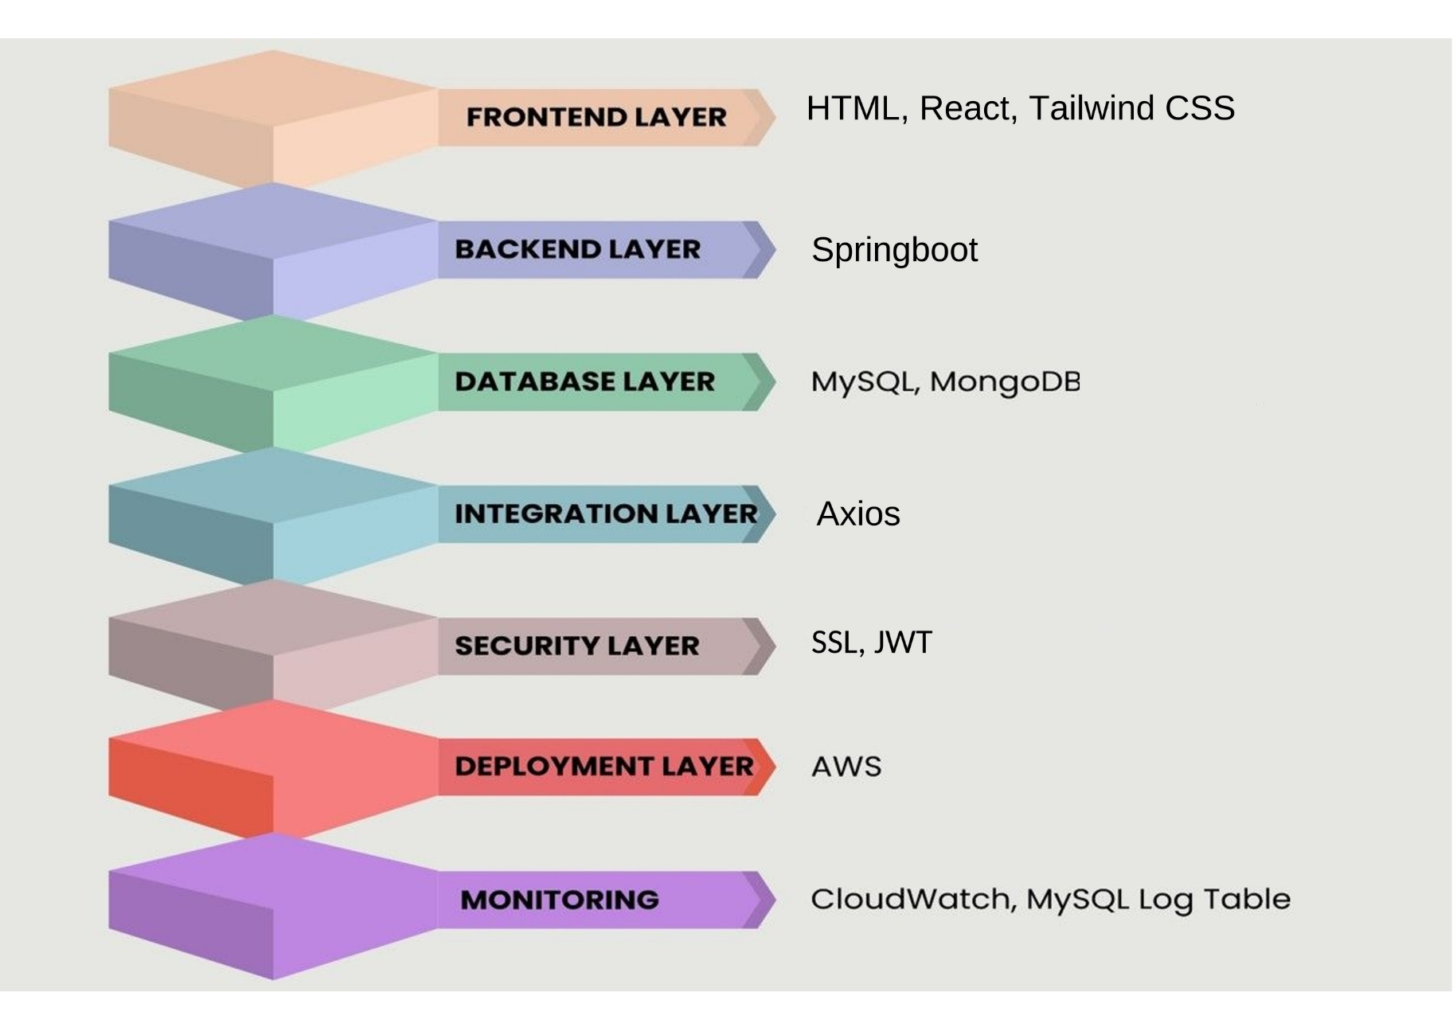
Architecture Design
ShareMyTrip Architecture: Microservices-based for modularity, scalability, and reliability.

Slide 14
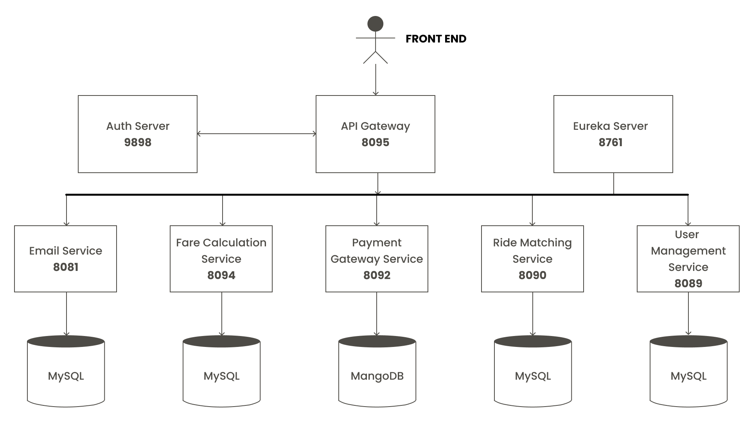
Architecture Design
ShareMyTrip Architecture: Microservices-based for modularity, scalability, and reliability.

Slide 15






Front-end Development
Tech Stack Used:
HTML, CSS, JavaScript
React , Tailwind
Tools:
GitHub,VS Code

Slide 16





Back-end Development
Tech Stack Used:
SQL
NoSQL
SpringBoot
Tools:
STS
MySQL Workbench
MongoDB Atlas
Postman
IntelliJ

Slide 17
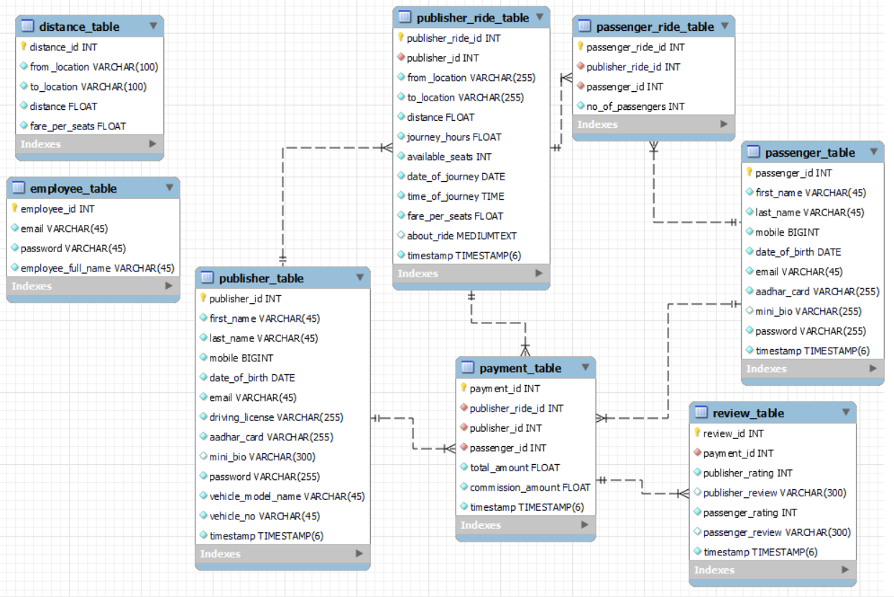
Database (MySQL) – ER Diagram

Slide 18
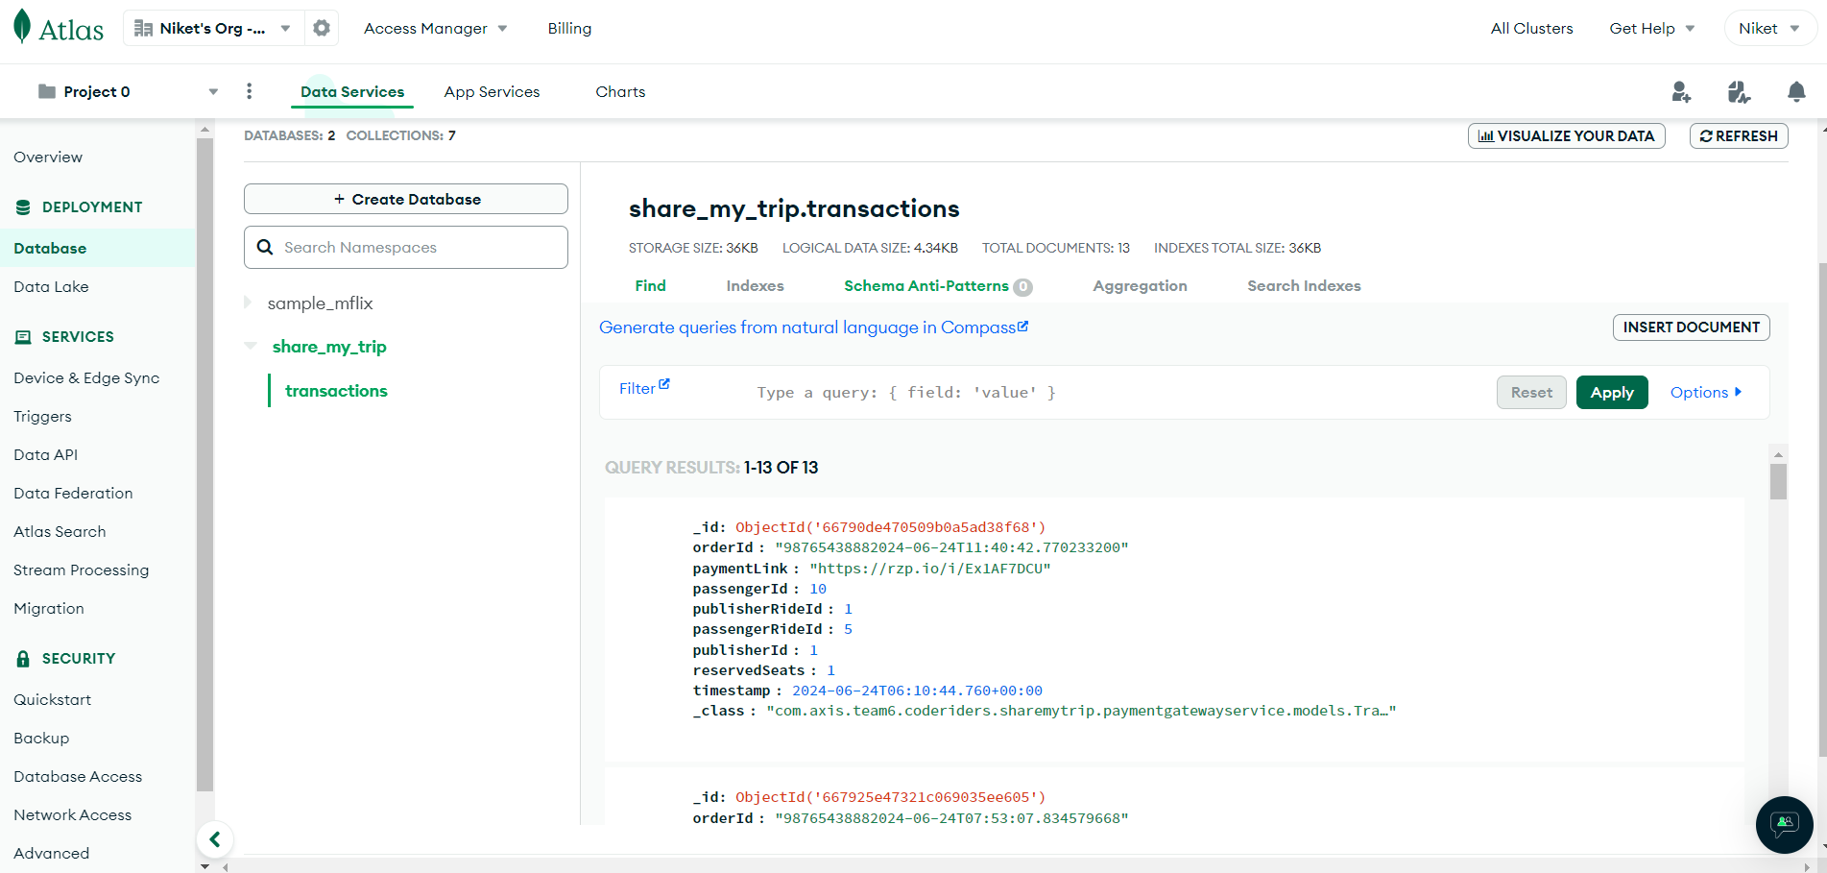
Database (MongoDB)

Slide 19
Live Demo

Slide 20



Integration and Testing
Junit: We will use Junit for unit testing to verify that individual units of code function as expected and meet design specifications.
SonarQube: We will use SonarQube to generate Code Coverage Reports as well as check for security and maintainability issues.
Selenium: We will use Selenuim to automate tests for web applications.

Slide 21
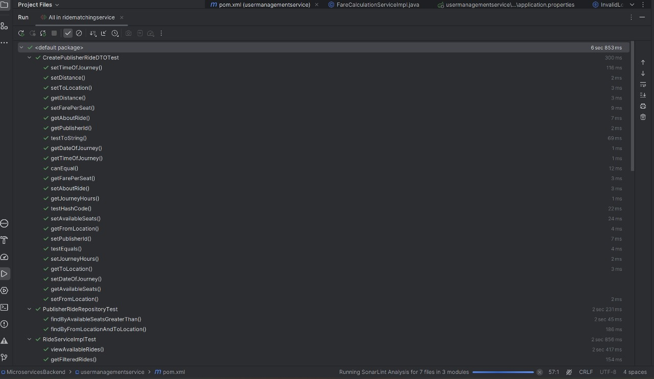
Integration and Testing
Unit Testing
Purpose: Validate individual components for correct functionality.
Tool: JUnit.
URL: https://share-my-trip.s3.ap-south-1.amazonaws.com/agile/Test+Report+Junit+%26+SonarQube.pdf

Slide 22
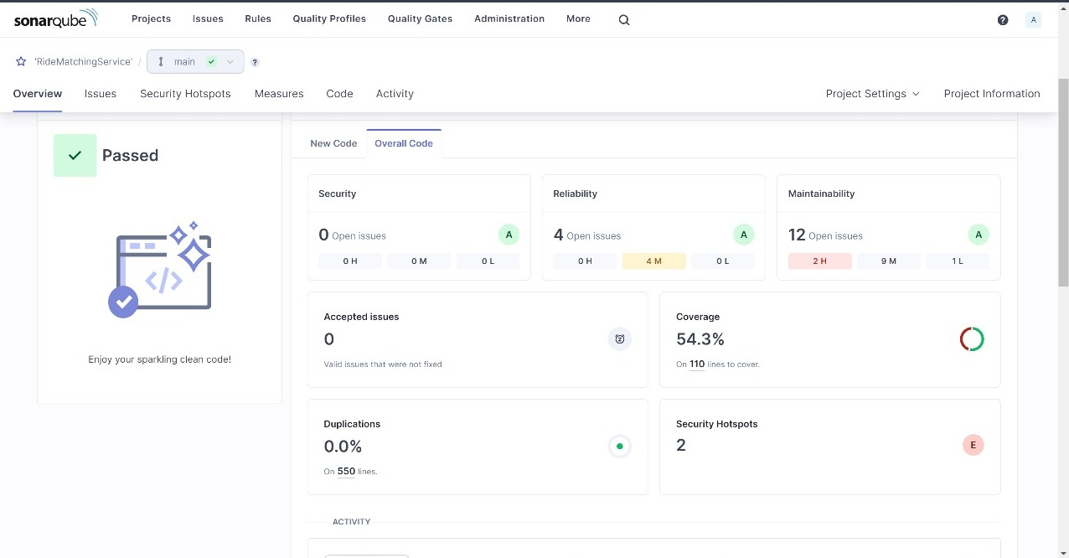
Sonarqube Analysis

Slide 23
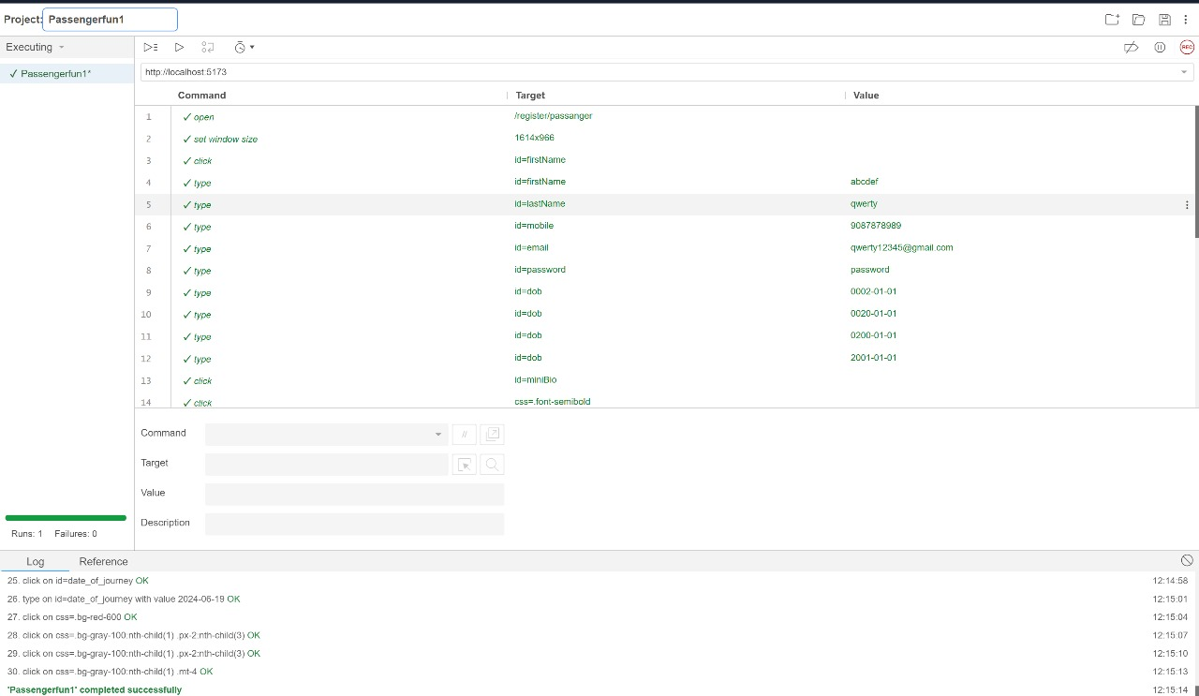
Selenium Test

Slide 24
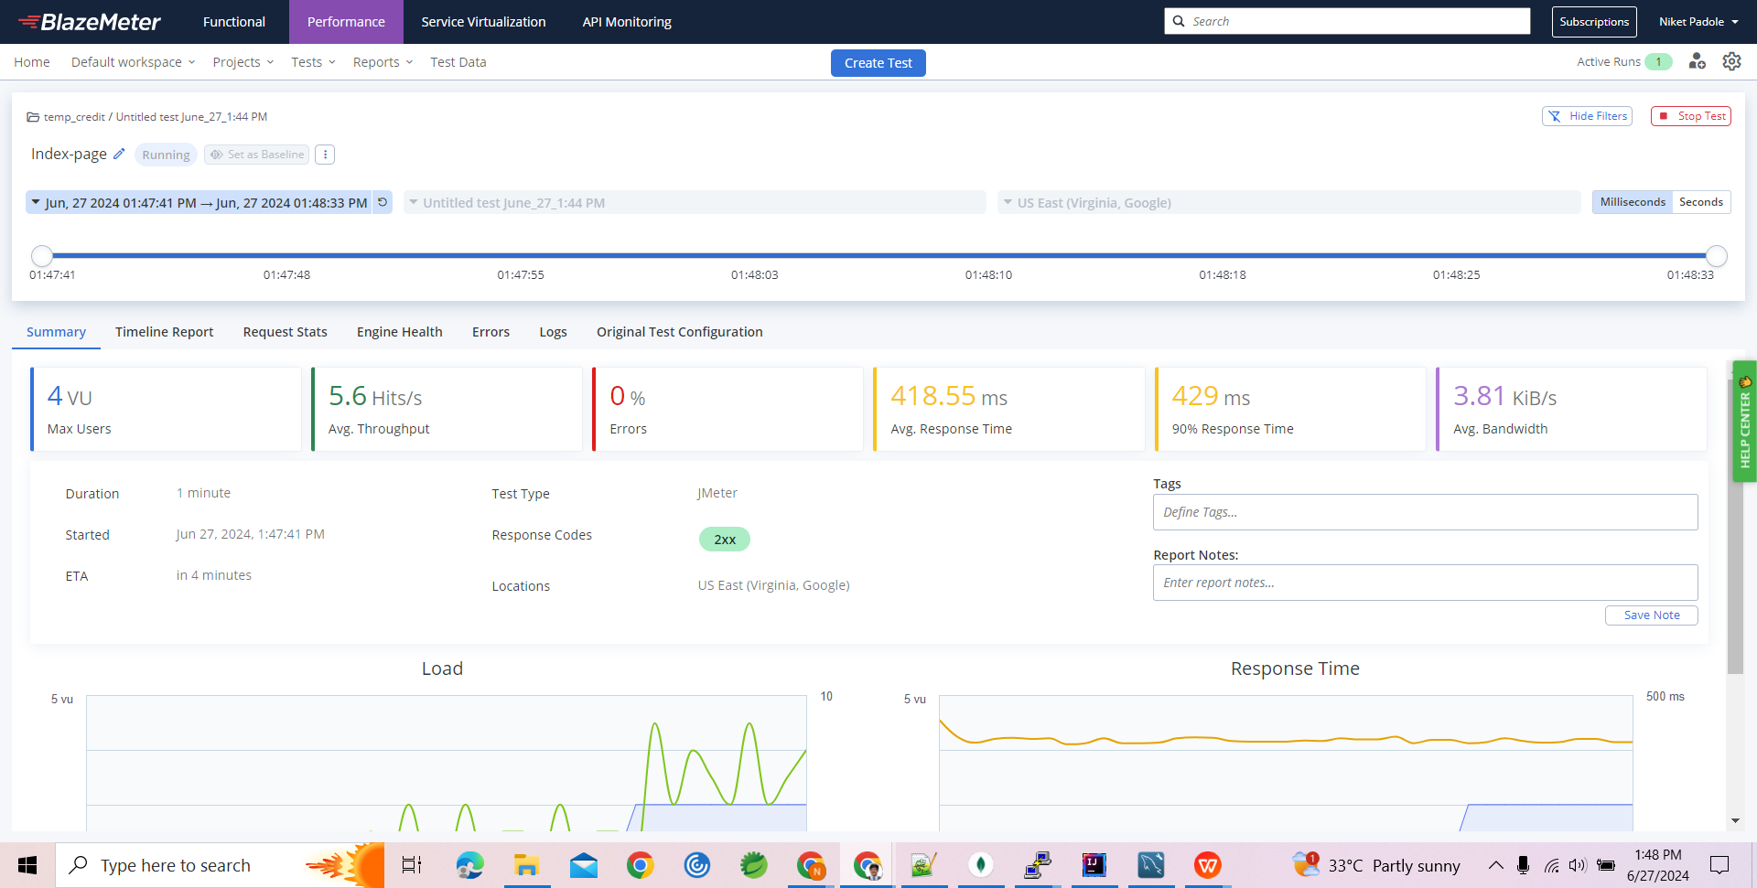
Performace Test
Using BlazeMeter for load testing, we simulate high user traffic to evaluate ShareMyTrip's performance.

Slide 25
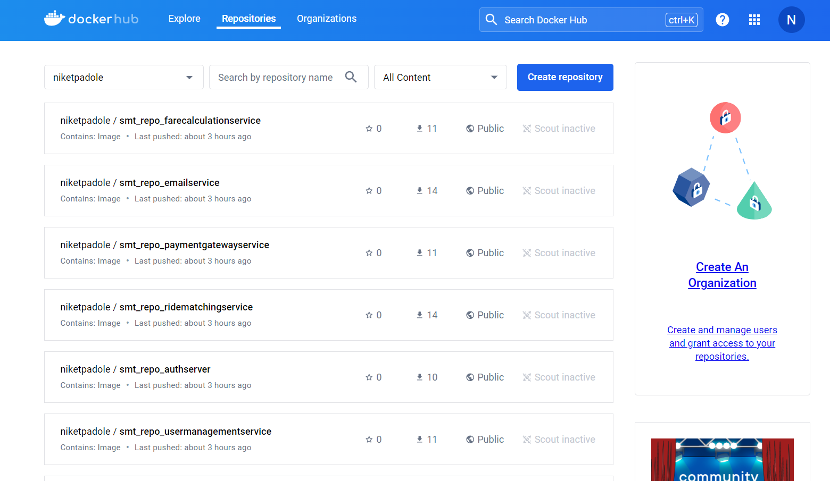
Docker Orchestration

Slide 26
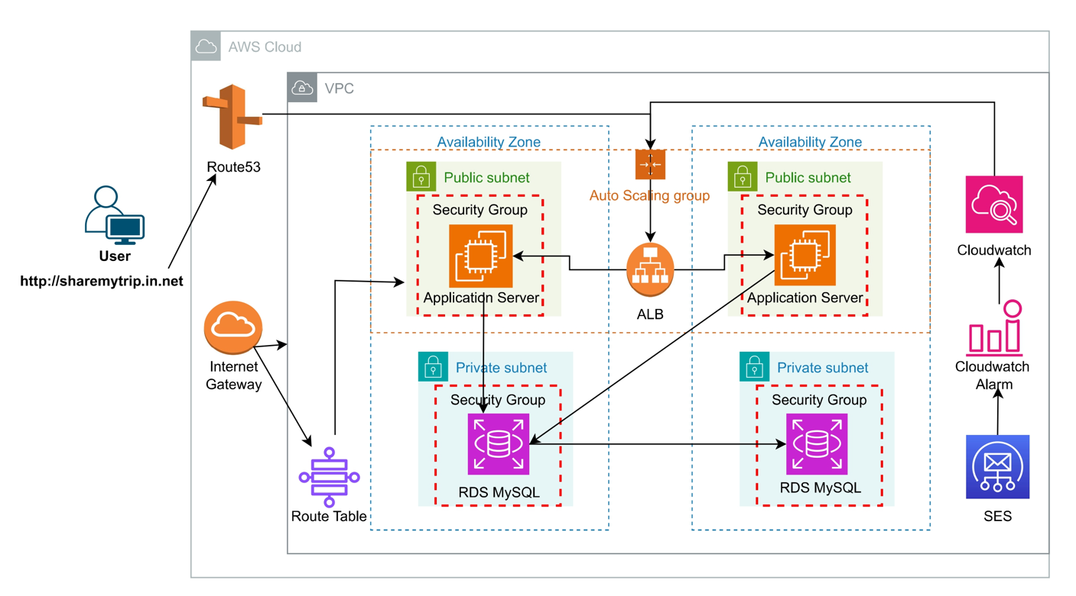
Deployment
Deploying ShareMyTrip on AWS cloud simplifies the deployment process through automation, provides scalability to handle varying loads, and offers integrated monitoring tools for effective management and maintenance.

Slide 27
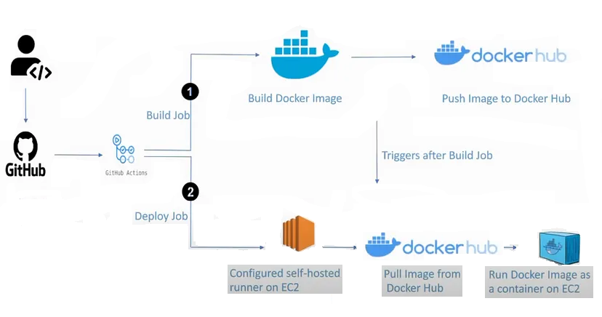
CI/CD Pipeline

Slide 28
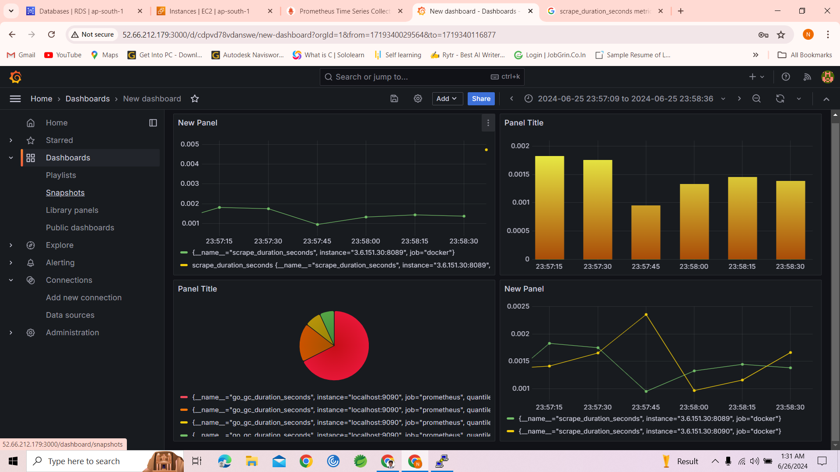
Grafana
We use Grafana to monitor Docker containers

Slide 29
Conclusion
ShareMyTrip application, structured around a microservices architecture, offers a holistic solution to modern transportation demands.
With specialized services handling user management, ride matching, fare calculation, trip management, and payment processing, it delivers a seamless experience for both drivers and passengers.
By promoting cost-effective travel, reducing environmental impact, and alleviating traffic congestion, the application embodies innovation in urban mobility, paving the way for a sustainable future.

Slide 30
Challenges
Real-Time Processing: Providing real-time updates and processing for user interactions.
Security Implementation: Ensuring robust protection of user data.
User Experience: Designing an intuitive and functional interface for diverse users.
System Integration: Seamless system integration with various services to provide real-time data processing, secure transactions, and reliable customer service.
Normalizing Database: Normalizing the database to remove redundancy.
.

Slide 31
Future Work
Adding Review features for Passenger and Publisher.
Passenger Reviews: Implement a feature where passengers can rate and review their rides.
Publisher Reviews: Enable publishers to rate passengers based on their behavior and punctuality.
Adding Google Map Services for Real Time Tracking.
Live Tracking: Integrate Google Maps to provide real-time tracking of rides.
Route Optimization: Use Google Maps services to suggest the most efficient routes for rides, considering traffic and road conditions, to reduce travel time and improve user satisfaction.

Slide 32
References
https://spring.io/projects/spring-boot
https://junit.org/junit5/
https://getbootstrap.com/
https://www.w3schools.com/mysql/mysql_intro.asp
https://www.w3schools.com/mongodb/
https://www.sonarsource.com/products/sonarqube/
https://www.blazemeter.com/

Slide 33
Thank You

